Slide 1
Project Update
Saransh Bhalla
Sainadh Chilukamari

Slide 2
Representation of Problem
The data is a set of attribute value vectors.
The data fields of the examples includes:
ID: The numeric id of the article
Title: The headline of the article
URL: The url of the article
Category: The category of the news item; one of b: business, t: science & technology, e: entertainment, m: health.
Publisher: The publisher of the article
Story: Alphanumeric ID of the news story that the article discusses.
Hostname and Timestamp.

Slide 3
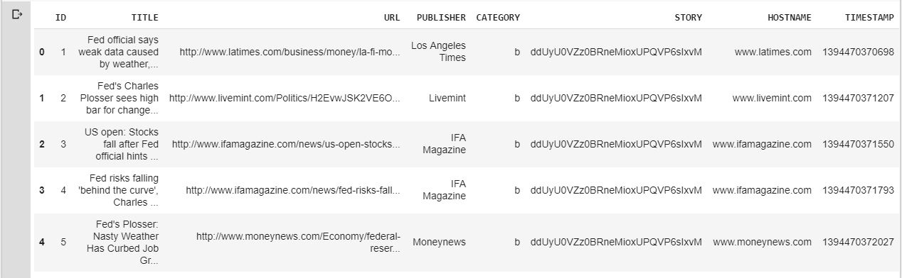
Business: 115967, entertainment: 152469, health: 45639, science & technology: 108344

Slide 4
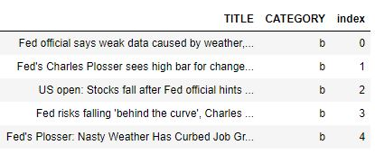

Slide 5
Data Preprocessing
Removing Punctuation
Removing Stop words
Stemming is performed to reduce a word to its stem/root.
Expanding Abbreviations
Python libraries to use:
nltk - natural language toolkit
sklearn

Slide 6
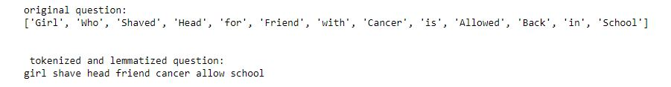
Sample preprocessed headline
Even after preprocessing the headlines, still the data is in unstructured form with different lengths.
We have transformed the data as structured data by creating document - term matrix using tf-idf vectorizer.

Slide 7
Where do we go from here
Next, we take our output of the data, then we input this data into a tool to build the model.
Top models for consideration:
RandomForestClassifier
Multinomial Naive Bayes

Slide 8
Model Evaluation
Use GridSearchCV to perform hyper parameter optimisation, that is, it is a method to find the best combination of hyper-parameters (an example of an hyper-parameter is the learning rate of the optimiser), for a given model and test dataset.
Use F1_score metrics as a scoring function for GridSearchCV.

Slide 9
Questions?

